Slide 1
Anime preference
Kenzhebay Yerzhan
Saparzhan olzhas

Slide 2
Why Japan's preference for anime is different from other countries
Our goal is to find out the causes and suggest consequences of this question.
Find out how influential anime is on the world at the present time

Slide 3
Hypothesis
The main reason is the source of anime
When studying, we can find unexpected reasons
Critics' score does not give an accurate answer
There will be anomalous anime that could be popular not only in Japan but also in the world, but for some reason did not become so

Slide 4
Why is important ?
Anime has already a century of history but it has become popular in the last 10 years
It has a great influence on the consciousness of the society of a special younger generation
Anime has a large audience

Slide 5
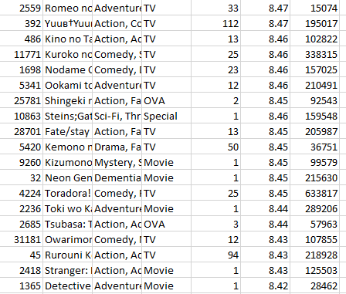

Slide 6
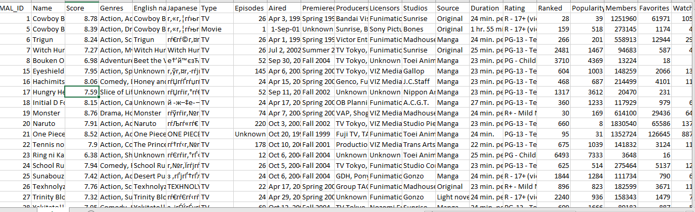

Slide 7
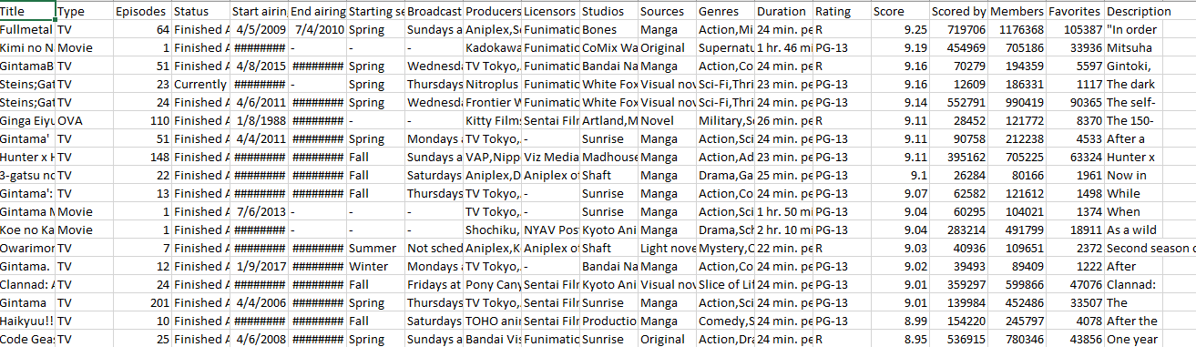

Slide 8
Background
1) Does anime, idol culture bring depression? Structural analysis and deep learning on subcultural identity and various psychological outcomes
Link: https://www.sciencedirect.com/science/article/pii/S2405844022018552
2) Fan Influence: The English-Speaking Anime and Manga Speech Community's Relationship with the Japanese Language and Gender Roles
Link: https://www.proquest.com/openview/09411f8b7b3d035fb94879feb90d15cb/1.pdf?pq-origsite=gscholar&cbl=18750&diss=y
3) The Many Faces of Internationalization in Japanese Anime
Link: https://journals.sagepub.com/doi/pdf/10.1177/1746847708091893?download=true

Slide 9
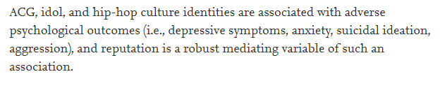
Does anime, idol culture bring depression? Structural analysis and deep learning on subcultural identity and various psychological outcomes

Slide 10
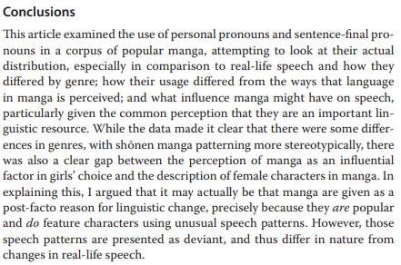
Fan Influence: The English-Speaking Anime and Manga Speech Community's Relationship with the Japanese Language and Gender Roles

Slide 11
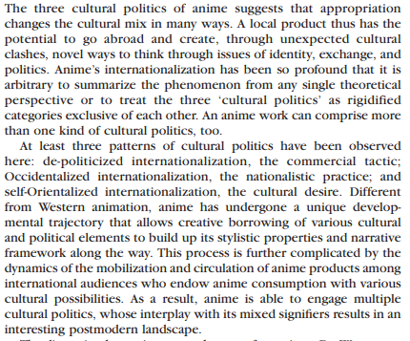
The Many Faces of Internationalization in Japanese Anime

